Slide 1
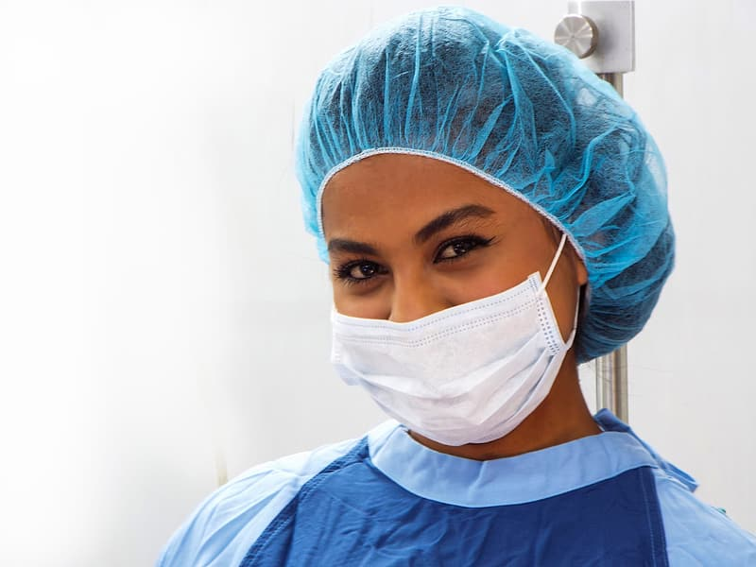
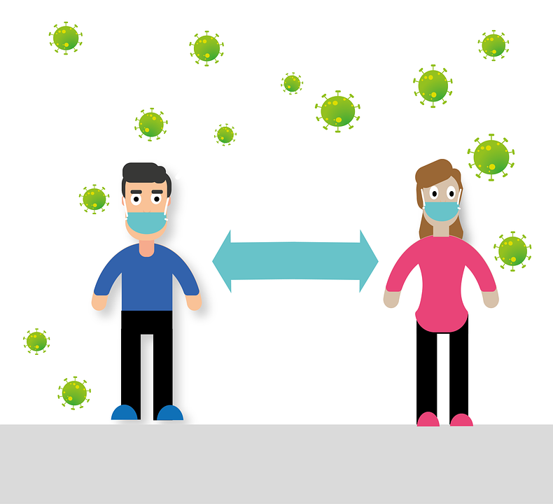
Social Distancing and Facemask Detection
Created by :- Devansh Goel (2K18/IT/044)
Prince Kirar (2K18/IT/086)

Slide 2

FaceMask Detection
Mask and Without mask prediction using YOLOv4 Object Detection Model.
Dataset includes photos of people with and without facemasks.
Trained YOLO v4 neural schema on both classes for around 3000 iterations.
Mean Average Precision (mAP) - 89%

Slide 3
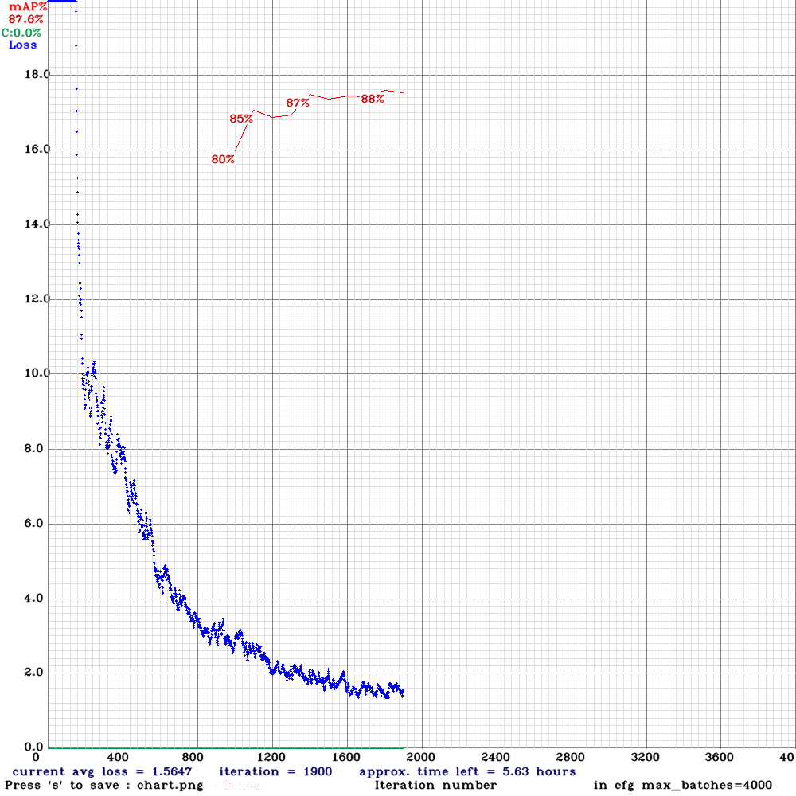
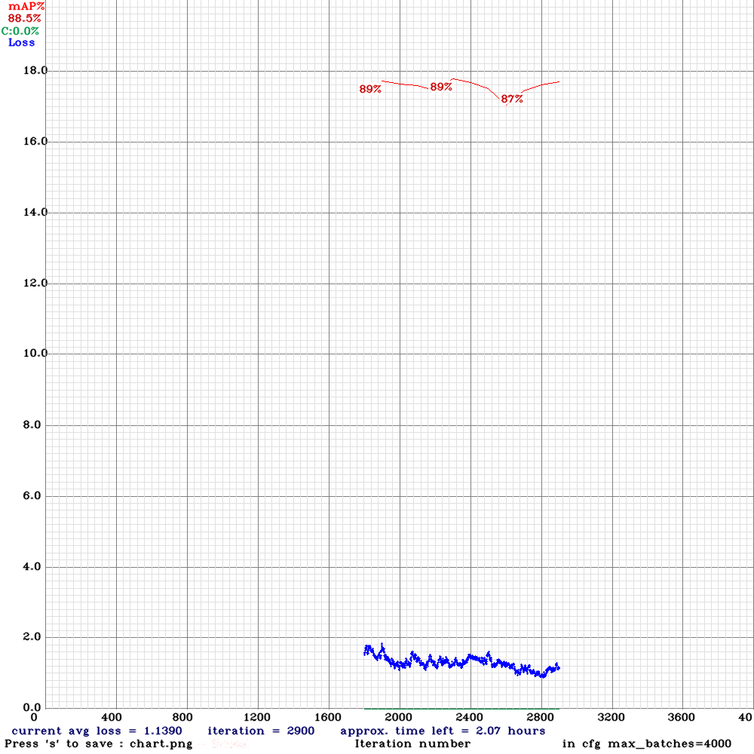
Epoch VS Accuracy graph

Slide 4
Social Distance Detection
Selected region of interest in frame.
Detect centroid coordinates of each person in ROI using YOLO v4.
Transformed centroids into bird eye view.
Determine social distancing using euclidean formula between transformed points.

Slide 5
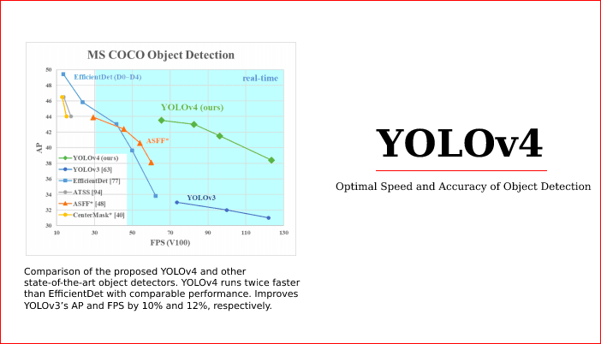
Why YOLO v4 ?
Real time speed of around 65 FPS on Tesla V100.
43% Average Precision(AP) on MS COCO Dataset
Training requires only one conventional GPU.

Slide 6

Applications
Help the government to monitor if people are following preventive measures for Covid19.
Assist people by notifying them if they are following social distancing and wearing face masks properly.
Minimize surveillance work for Police in containment zones and public areas.
Help companies and organizations by notifying them if their employees are following Covid19 measures and working in a safe environment.

Slide 7
Thank You

